Slide 1
INSURANCE MANAGEMENT SYSTEM

Slide 2
ABSTRACT
This project insurance management system deals with insurance. This tool taking care of the policy in using tracking the details of the customer. Customer can apply and view their insurance policy details. The main objective of the application is to automate all the possible functionalities of insurance and provide the insurance service to the customers. Using this system agents and customers can know the details about present policies, new policies, policy specifications, policy terms and conditions, etc. This system also calculates agent commission is based upon customer policy registration.
This system maintains profile management of all policy holders. This system providing interface to customer that helps to him to know his policy details. Payment process also like ecommerce transaction. Customers can pay their policies. The payment processes are hassle-free and customer can complete a transaction at a much lesser time.

Slide 3
HARDWARE SPECFICATION
Processor : P 4 700 ghz.
Ram : 4 gb ram
Hard disk drive : 180 GB

Slide 4
SOFTWARE SPECIFICATION
Operating system : windows 7/8/10
Front end : JAVA
Back end : ORACLE

Slide 5
EXISTING SYSTEM
The existing system is the manual system. It is time consuming. It is difficult to search for a data most of the insurance organizations are not having any existing fully computerized system. It is very difficult for a person to produce the report. There are chances for changing the scheme report and do malpractice. They are managing the information in the form of excel spread sheets. This system involves a lot of manual entries with the applications to perform the desired task. Every member organization has its own data structure. Usage of papers in the payment process leads to less efficiency, less accuracy and less productivity. Due to lack of centralized data structure, it is very difficult to merge the data to analyze the statistics
Disadvantages
Huge process of creating an insurance account
More number of papers are wasted for insurance
No records can be maintained

Slide 6
PROPOSED SYSTEM
The proposed system is for making easier to manage policy holder details, agent details, policy details, claimant details and payment details. The proposed system is designed to eliminate the drawbacks of the existing system. It is designed by keeping to eliminate the drawbacks of the present system in order to provide a permanent solution to the problems. The primary aim of the new system is to speedup transactions. This insurance management system will be developed for managing the insurance management system. The overall system is control through the main menu. The report is prepared for the schemes and implemented by the concerned officials.
Advantages
Can easily contact the agent
All the records are maintained by the administrator
Easy to manage the software

Slide 7
Modules
Policy registration module
New policy holder gives their information like, name, password, ac no, bank, organization, occupation, age, sex, address, e-mail id. DFD, UML diagram, screen shots, paper presentation, output presents the insurance management system project
Customer account module
The customer account module is when the customer registers the form and can able to access login, here they can check the customer account details as well as policy renewal.
Policy payment module
This module the customer can directly pay the insurance renewal for this module, once the date has crossed then the user will get the alert for the policy details then can pay it.

Slide 8
Agent registration module
An agent can able to register by the administrator, once the agent has been added they will have unique username and password. Using this credential to login into the application. Once they register, they can able to create the customer account.
Report module
Also, the agent has report to for them customer details as well as policy and renewal details. Once the process has been done, they will generate report to the respective insurance team.

Slide 9
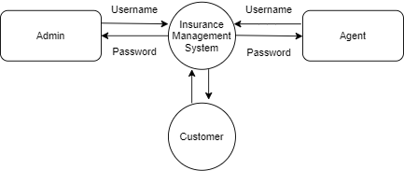
Data Flow Diagram
Level 0

Slide 10
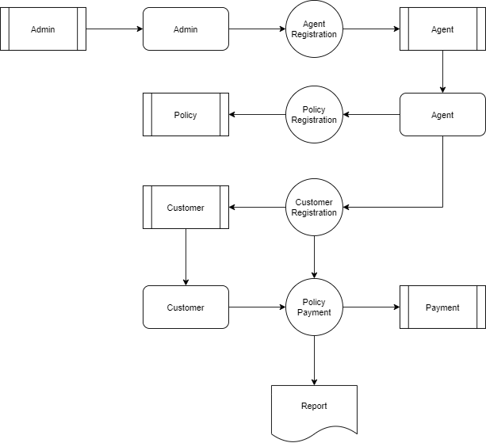
Level 1:

Slide 11
Table name: admin
FIELD | DATA TYPE | SIZE | CONSTRAINT
Username | Varchar | 10 | Not null
Password | Varchar | 5 | Not null

Slide 12
TABLE NAME: AGENT
FIELD | DATA TYPE | SIZE | CONSTRAINT
Agent id | Int | 5 | Primary key
First name | Varchar | 10 | Not null
Last name | Varchar | 10 | Not null
D.O.B | Date | 8 | Not null
Gender | Varchar | 5 | Not null
Mobile no | Int | 10 | Not null
Age | Int | 2 | Not null
State | Varchar | 20 | Not null
City | Varchar | 20 | Not null
Pincode | Int | 7 | Not null
Address | Varchar | 30 | Not null
Experience | Int | 2 | Not null
Password | Varchar | 5 | Not null

Slide 13
TABLE NAME: customer
FIELD | DATA TYPE | SIZE | CONSTRAINT
Customer id | Int | 5 | Primary key
First name | Varchar | 10 | Not null
Last name | Varchar | 10 | Not null
D.O.B | Date | 8 | Not null
Gender | Varchar | 7 | Not null
Age | Int | 2 | Not null
Mobile.no | Int | 10 | Not null
State | Varchar | 15 | Not null
City | Varchar | 20 | Not null
Pincode | Int | 7 | Not null
Address | Varchar | 20 | Not null
Occupation | Varchar | 10 | Not null
Agent id | Int | 5 | Not null

Slide 14
TABLE NAME: POLICY
FIELD | DATA TYPE | SIZE | CONSTRAINT
Policy id | Int | 5 | Not null
Policy name | Varchar | 20 | Not null
Policy category | Varchar | 20 | Not null
Policy duration | Int | 2 | Not null
Policy status | Varchar | 10 | Not null
Policy date | Date | 8 | Not null
Policy expiry date | Date | 8 | Not null
Amount | Int | 7 | Not null

Slide 15
Table name: payment
FIELD | DATA TYPE | SIZE | CONSTRAINT
Payment id | Int | 5 | Primary key
Policy id | Int | 5 | Foreign key
Customer id | Int | 5 | Foreign key
Agent id | Int | 5 | Foreign key
Last payment | Int | 7 | Not null
Remaining amount | Int | 7 | Not null

Slide 16
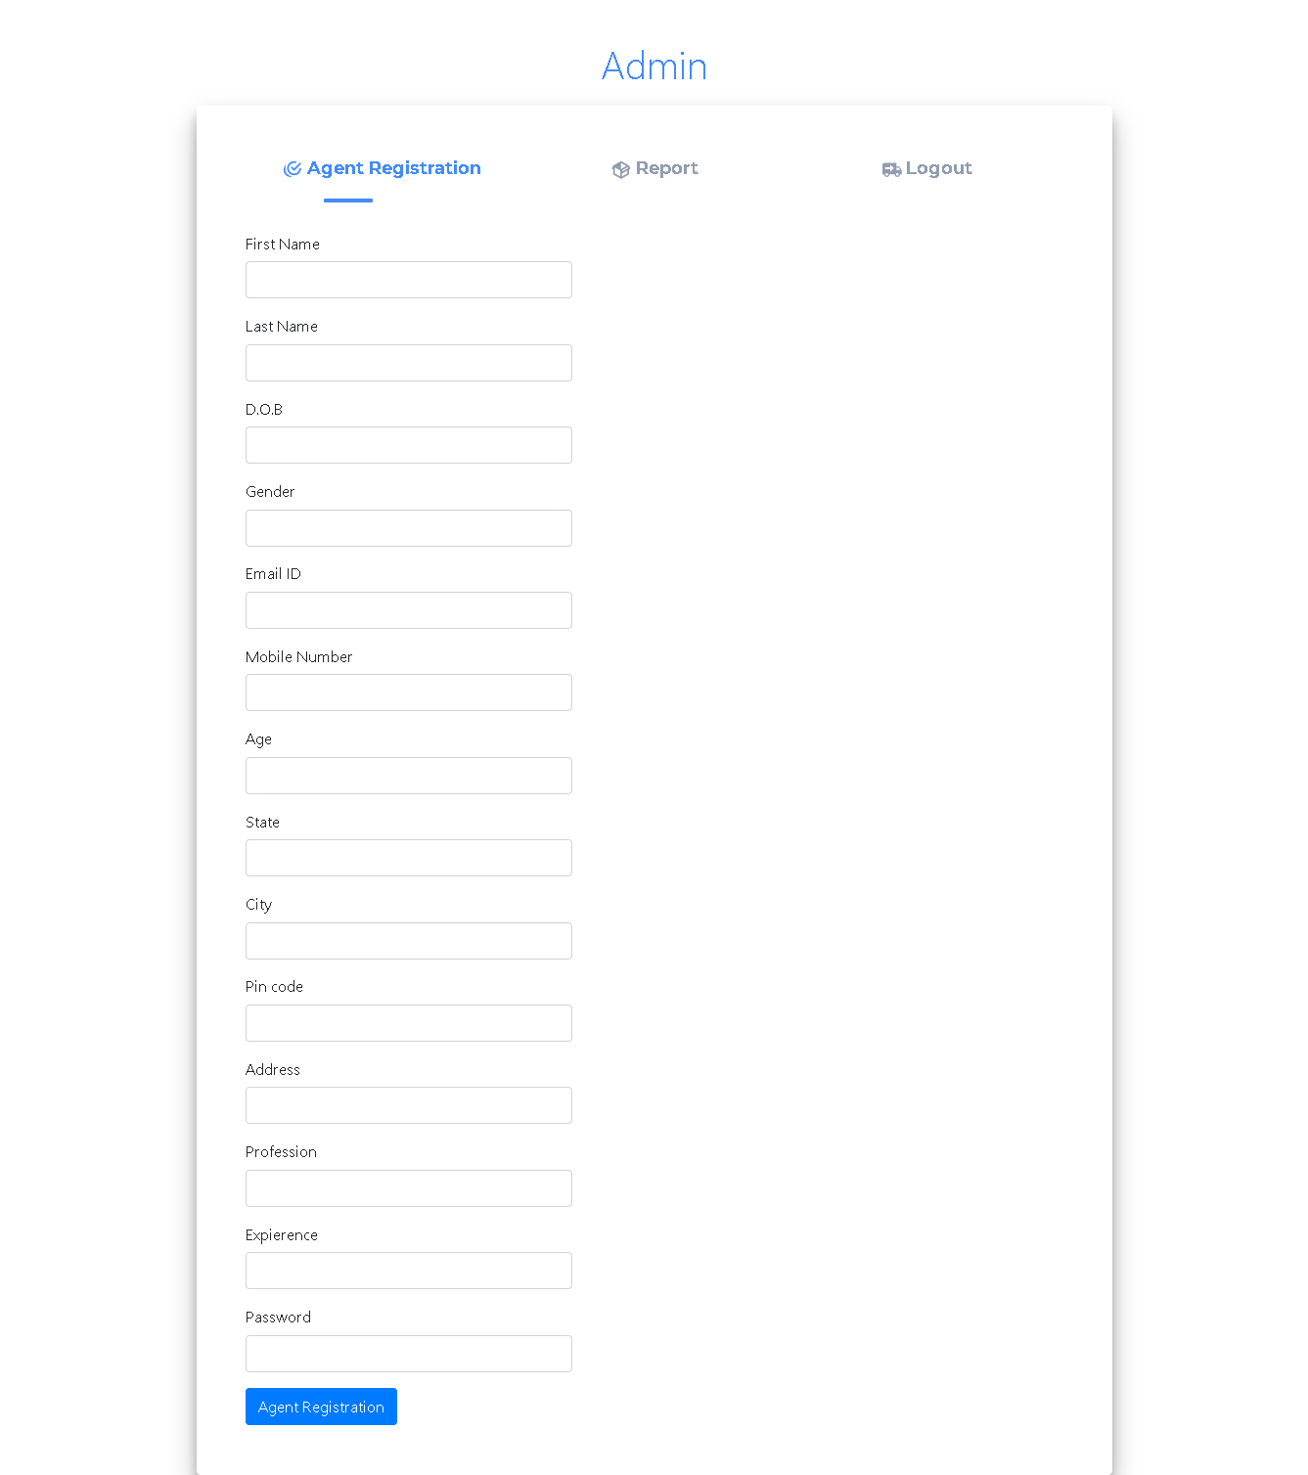

Slide 17
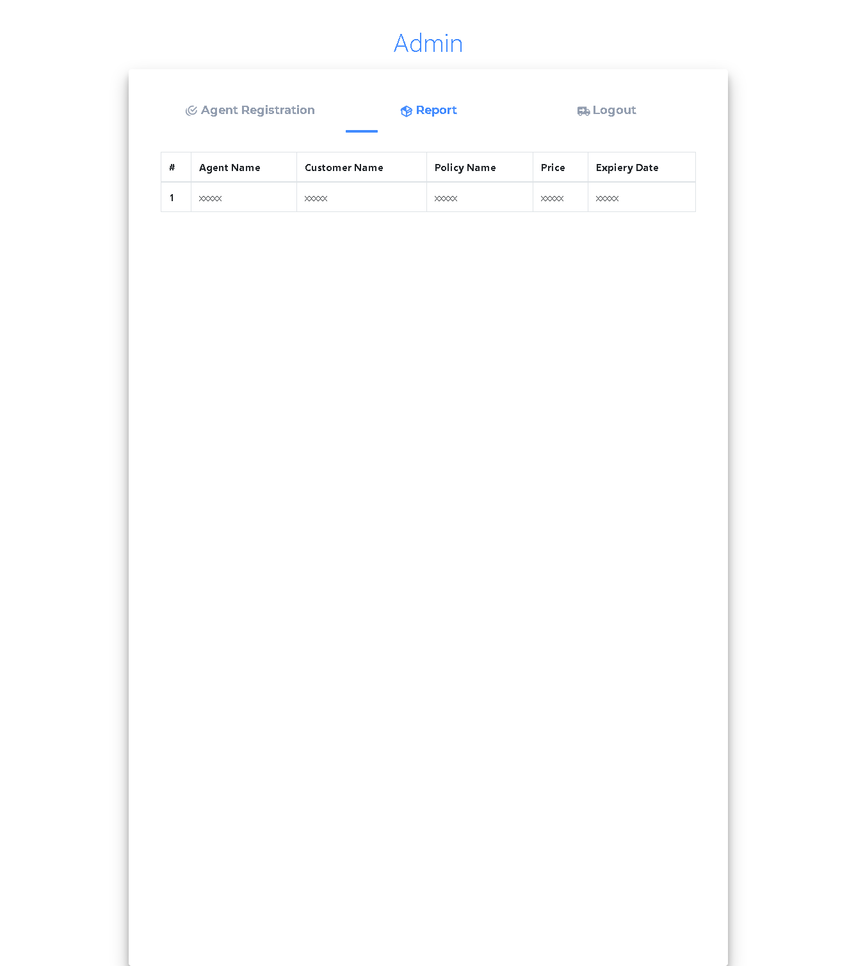

Slide 19
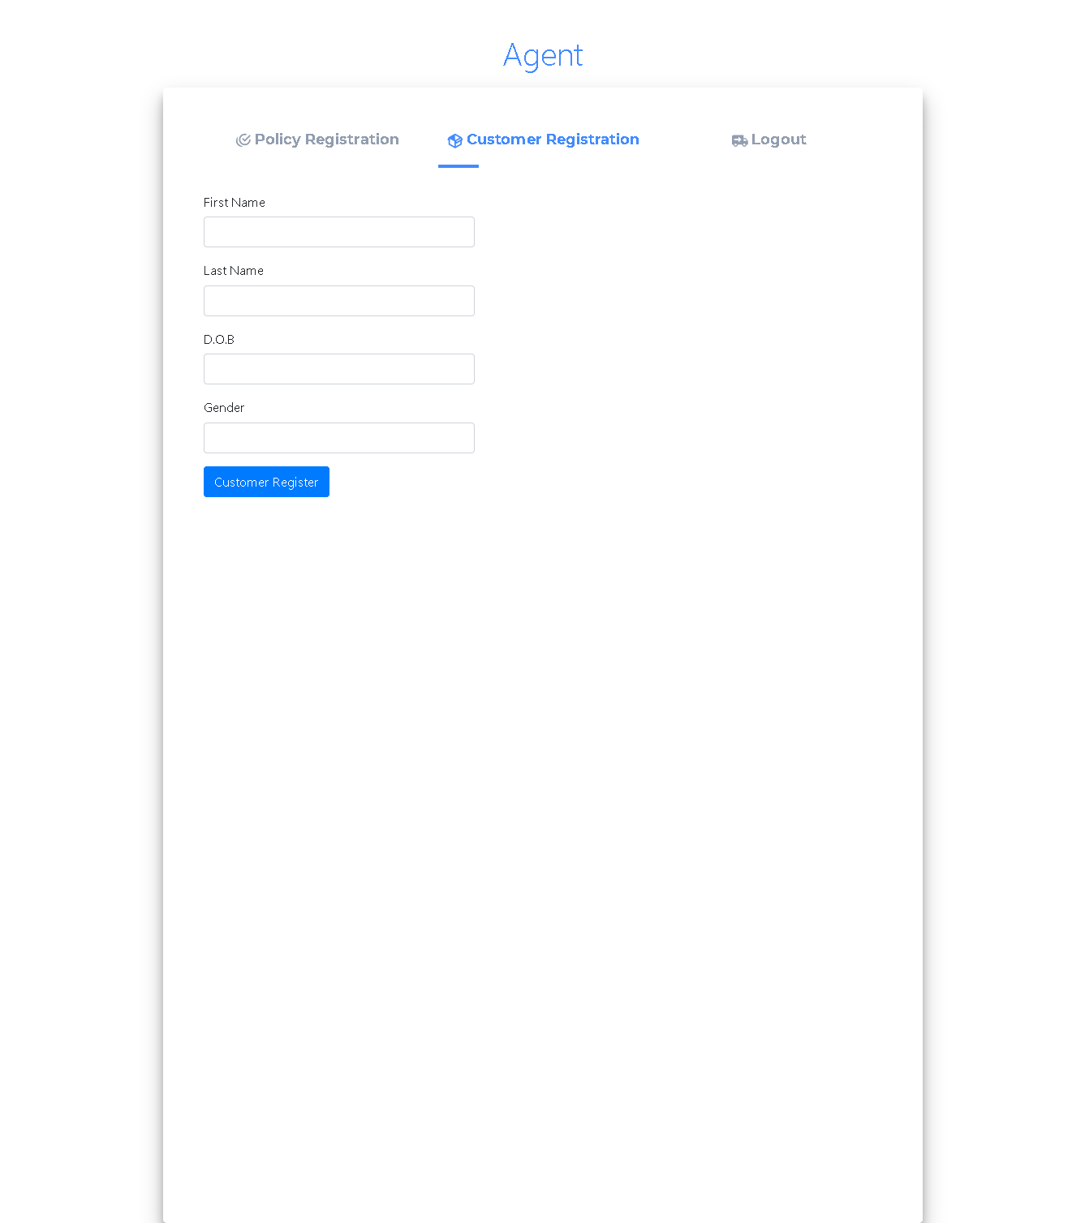

Slide 20
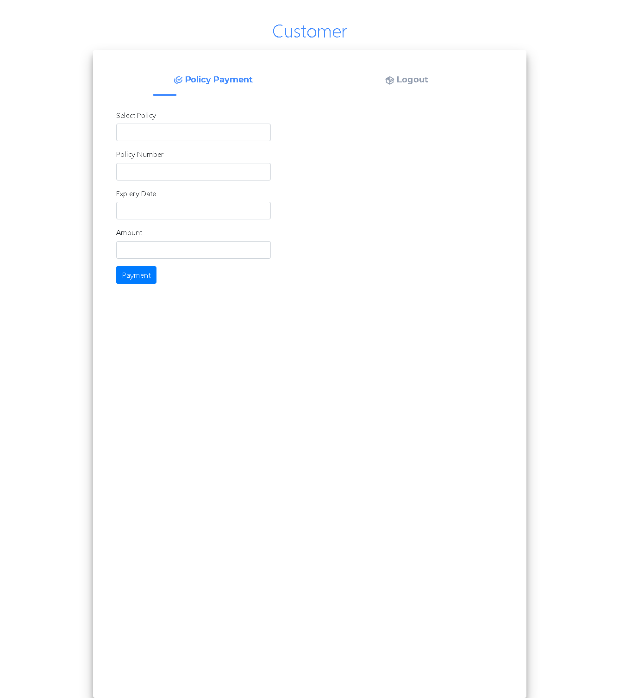

Slide 21
Table name: admin
FIELD | DATA TYPE | SIZE | CONSTRAINT
Username | Varchar | 10 | Not null
Password | Varchar | 5 | Not null

Slide 22
TABLE NAME: AGENT
FIELD | DATA TYPE | SIZE | CONSTRAINT
Agent id | Int | 5 | Primary key
First name | Varchar | 10 | Not null
Last name | Varchar | 10 | Not null
D.O.B | Date | 8 | Not null
Gender | Varchar | 5 | Not null
Mobile no | Int | 10 | Not null
Age | Int | 2 | Not null
State | Varchar | 20 | Not null
City | Varchar | 20 | Not null
Pincode | Int | 7 | Not null
Address | Varchar | 30 | Not null
Experience | Int | 2 | Not null
Password | Varchar | 5 | Not null

Slide 23
TABLE NAME: customer
FIELD | DATA TYPE | SIZE | CONSTRAINT
Customer id | Int | 5 | Primary key
First name | Varchar | 10 | Not null
Last name | Varchar | 10 | Not null
D.O.B | Date | 8 | Not null
Gender | Varchar | 7 | Not null
Age | Int | 2 | Not null
Mobile.no | Int | 10 | Not null
State | Varchar | 15 | Not null
City | Varchar | 20 | Not null
Pincode | Int | 7 | Not null
Address | Varchar | 20 | Not null
Occupation | Varchar | 10 | Not null
Agent id | Int | 5 | Not null

Slide 24
TABLE NAME: POLICY
FIELD | DATA TYPE | SIZE | CONSTRAINT
Policy id | Int | 5 | Not null
Policy name | Varchar | 20 | Not null
Policy category | Varchar | 20 | Not null
Policy duration | Int | 2 | Not null
Policy status | Varchar | 10 | Not null
Policy date | Date | 8 | Not null
Policy expiry date | Date | 8 | Not null
Amount | Int | 7 | Not null

Slide 25
Table name: payment
FIELD | DATA TYPE | SIZE | CONSTRAINT
Payment id | Int | 5 | Primary key
Policy id | Int | 5 | Foreign key
Customer id | Int | 5 | Foreign key
Agent id | Int | 5 | Foreign key
Last payment | Int | 7 | Not null
Remaining amount | Int | 7 | Not null

Slide 31
Thank You

